Slide 1
TEACHER’S PERSONAL INFORMATION
Name: Nguyen Thanh Loan
Facebook: Loan Nguyễn Thanh
Mobile number: 0942 255 937
Email: loannguyenthanh1978@gmail.com

Slide 2
UNIT 9
Lesson 4
VOCABULARY PLUS
Health

Slide 3
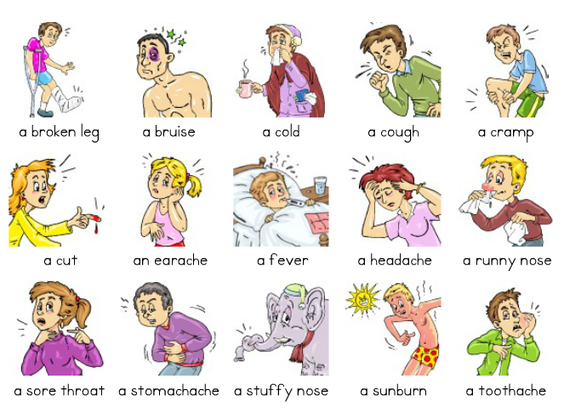
VOCABULARY PLUS
Health

Slide 4

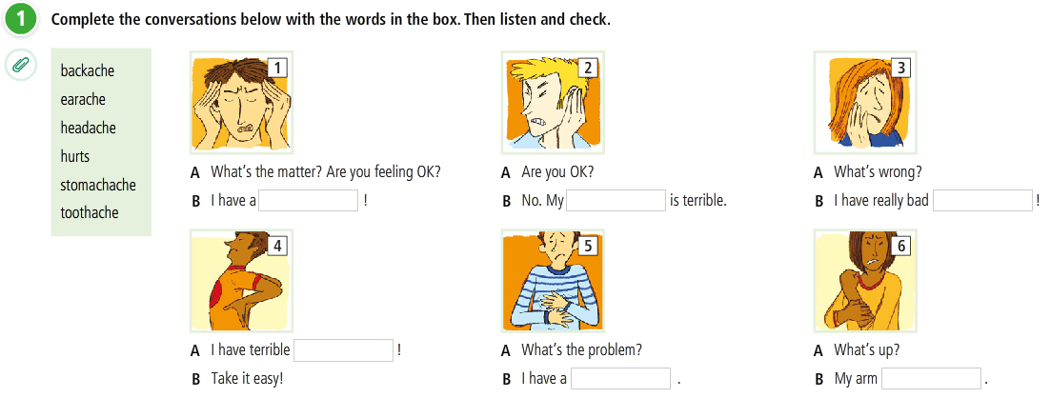
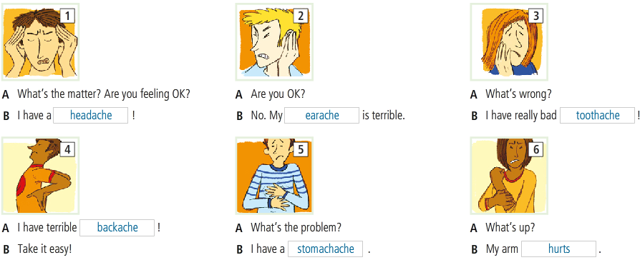
LISTENING
Health

Slide 5
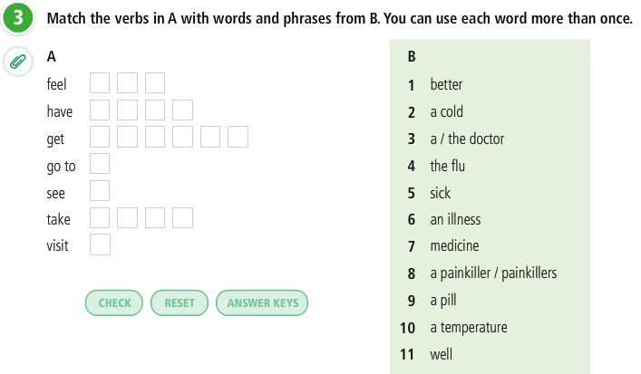
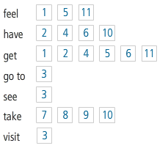
VOCABULARY PLUS
Health phrases

Slide 6
Health phrases
Feel better
Get well
Feel sick
Go to the doctor
Feel well
See the doctor
Have a cold
Take medicine
Take a painkiller/painkillers
Have the flu
Take a pill
Have an illness
Have a temperature
Visit the doctor
Get better
Get a cold
Get the flu
Get sick
Get an illness

Slide 7
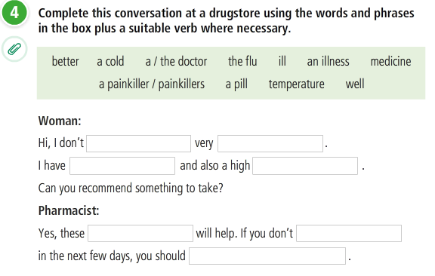
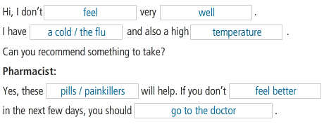

Slide 8
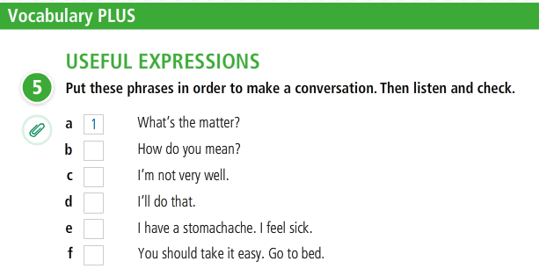


Slide 9
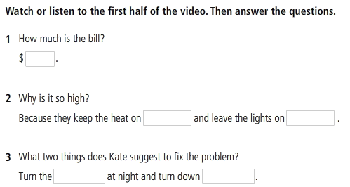
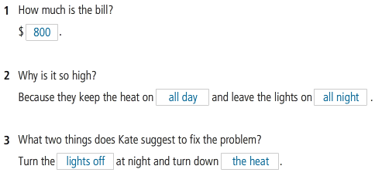
LANGUAGE IN ACTION
MANAGING A CONVERSATION

Slide 10
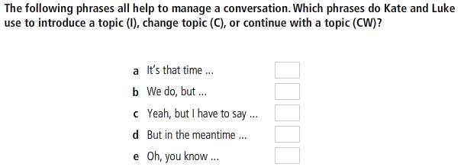

MANAGING A CONVERSATION

Slide 11
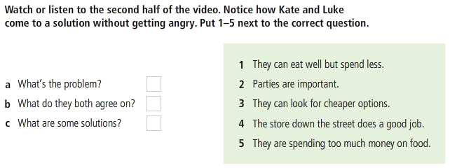
MANAGING A CONVERSATION

Slide 12
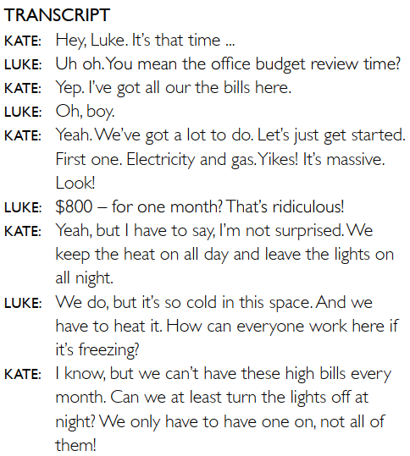
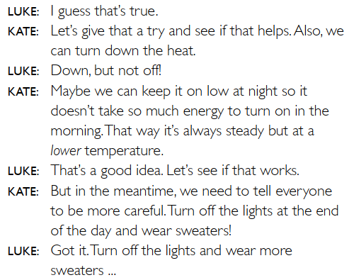
LANGUAGE IN ACTION
MANAGING A CONVERSATION

Slide 13
References
Practice English conversation: Medical problems and advice
https://www.youtube.com/watch?v=2PCgztYXnxk
https://www.youtube.com/watch?v=lmYOtkY1A8Y
https://www.youtube.com/watch?v=thNkJDhTWEM
Speaking: Managing the cost of living
https://www.youtube.com/watch?v=hqt3mRgaA5g

